Slide 1
Application for Controlled Access to Remote Documents for Microsoft Windows
Adam Feranec
Supervisor:
RNDr. Rychlý Marek, Ph.D.
Opponent: Ing. Bartík Vladimír, Ing., Ph.D.
Brno University of Technology, Faculty of Information Technology
Božetěchova 1/2, 612 00 Brno, Czech Republic
xferan00@fit.vutbr.cz

Slide 2
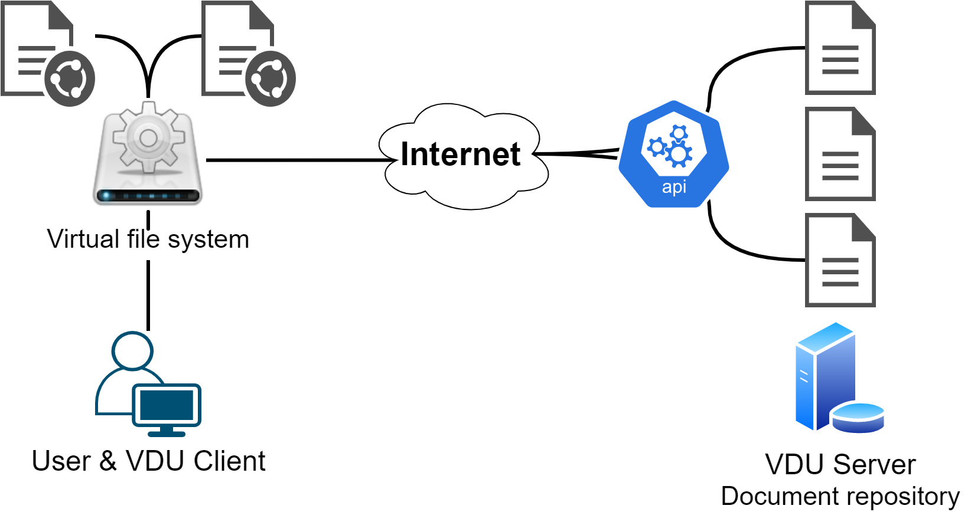
Motivation
Connect to the Validated Data Storage (VDU)
Provide access to remote documents
Application for Controlled Access to Remote Documents for Microsoft Windows
<number>/7

Slide 3
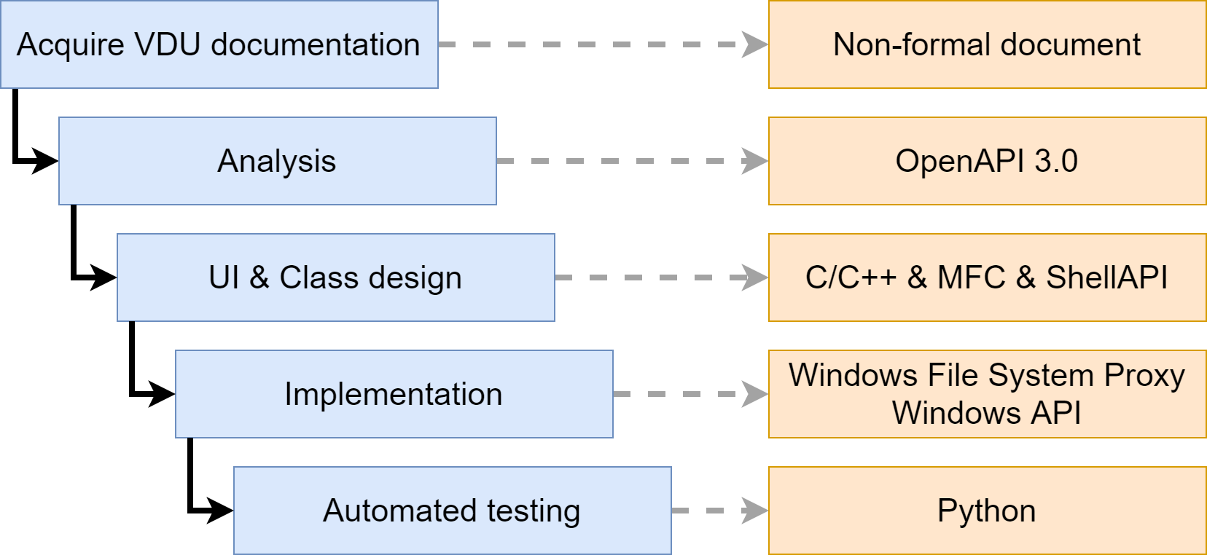
Development
Application for Controlled Access to Remote Documents for Microsoft Windows
<number>/7

Slide 4

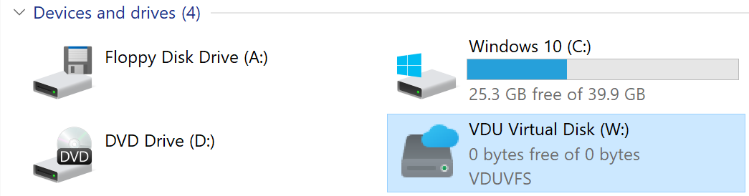
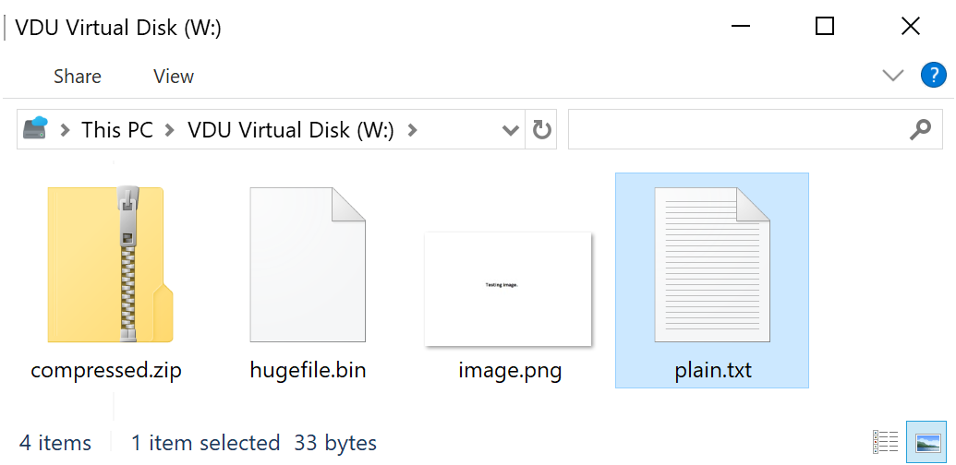
Custom virtual file system
Available via Windows File Explorer
Application for Controlled Access to Remote Documents for Microsoft Windows
<number>/7

Slide 5
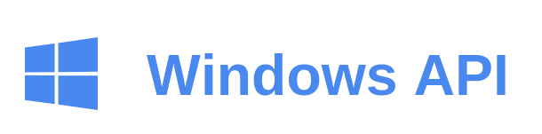
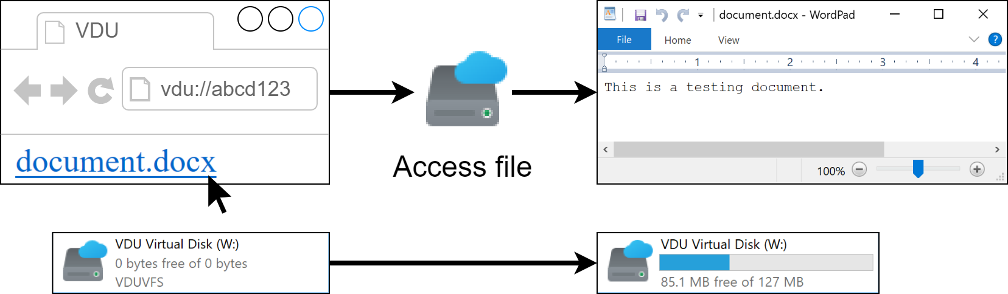
Custom URI protocol
One-click file access for hyperlinks
Automatic application startup
Application for Controlled Access to Remote Documents for Microsoft Windows
<number>/7

Slide 6

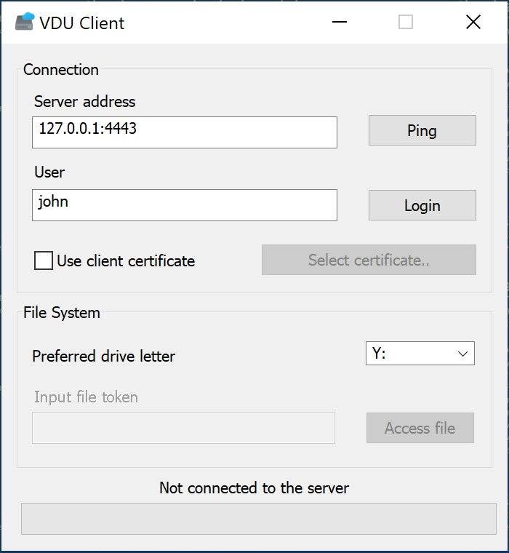
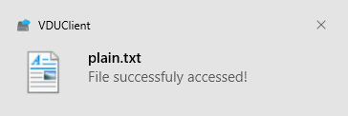

User interface
Dialog window, notifications and hints
Application for Controlled Access to Remote Documents for Microsoft Windows
<number>/7

Slide 7

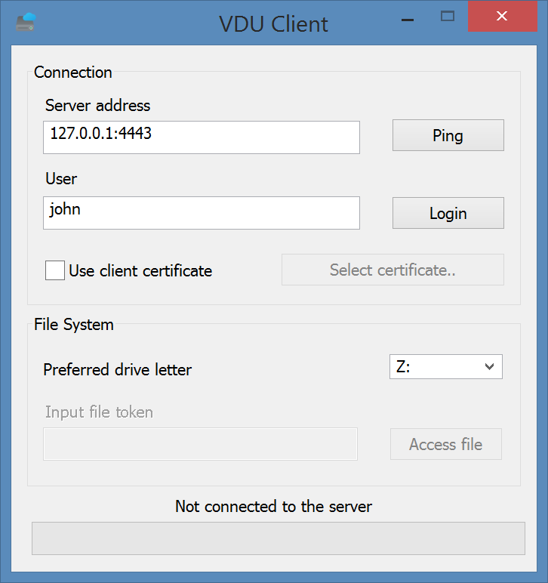
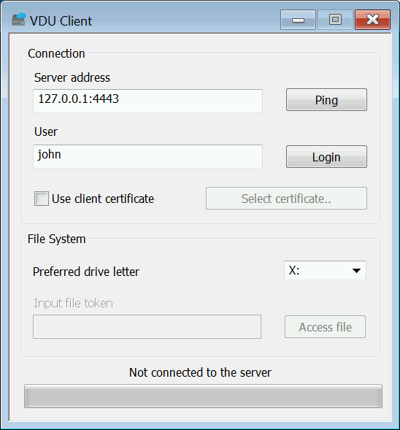
Backward compatibility
Support for Windows 8 and Windows 7
All tests passed successfully
Application for Controlled Access to Remote Documents for Microsoft Windows
<number>/7

Slide 8
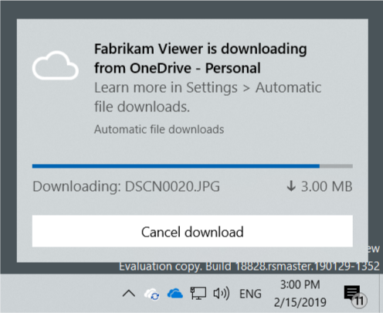
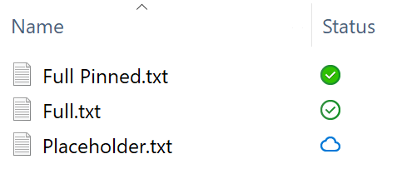
Otázky oponenta
Bylo by možné použít k danému účelu nějaké existující řešení? Pokud ano, popište, v čem se vaše řešení liší, popř. jaké má výhody.
    Žiadne existujúce riešenie pre tento účel
    Podobné riešenia - Cloud Sync Engine
Application for Controlled Access to Remote Documents for Microsoft Windows

